Slide 1
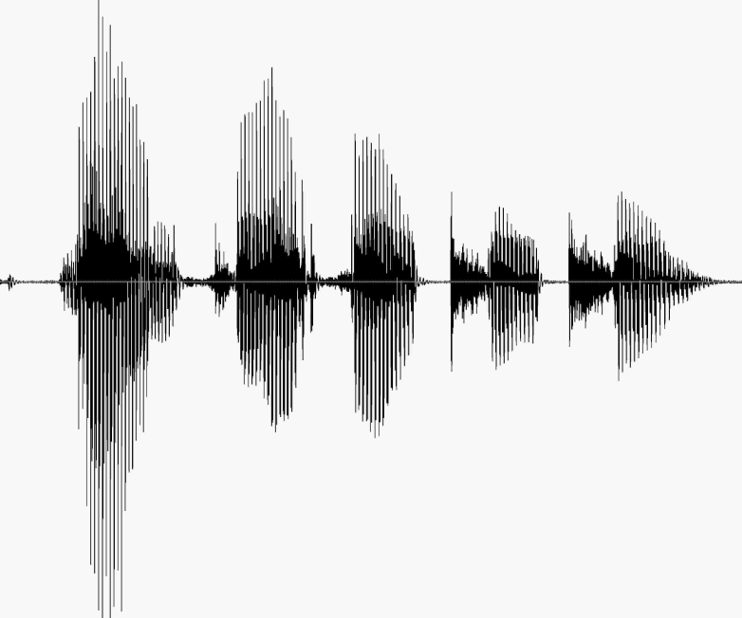
CS 224S / LINGUIST 285 Spoken Language Processing
Andrew Maas
Stanford University
Spring 2017
Lecture 16: Parametric TTS, Intoxication, Depression, Trauma, Personality
Original slides by Dan Jurafsky

Slide 2
Evaluation of TTS
Intelligibility Tests
Diagnostic Rhyme Test (DRT)
Humans do listening identification choice between two words differing by a single phonetic feature
Voicing, nasality, sustenation, sibilation
96 rhyming pairs
Veal/feel, meat/beat, vee/bee, zee/thee, etc
Subject hears “veal”, chooses either “veal or “feel”
Subject also hears “feel”, chooses either “veal” or “feel”
% of right answers is intelligibility score.
Overall Quality Tests
Have listeners rate space on a scale from 1 (bad) to 5 (excellent) (Mean Opinion Score)
AB Tests (prefer A, prefer B) (preference tests)
Huang, Acero, Hon

Slide 3
Parametric Synthesis
Developed by Tokuda and Zen
Proposed in mid-'90s, popular since 2007ish
Big idea: Use classifiers/regressors to predict all of F0, duration, spectral envelope. Synthesize everything
Initial work uses the same HMM we used for ASR, but in reverse

Slide 4
Parametric Synthesis
Small footprint
Don’t need huge amount of data to train
Flexible: easier to modify pitch for emotional change, or use MLLR adaptation to change voice characteristics
Smooth: no discontinuities in spectrum and prosody due to join artifacts
Too smooth: flat, monotone, spectral smearing in time
Vocoding effects: buzzy unnatural sound

Slide 5
HMM synthesis
Tokuda et al 2009

Slide 6
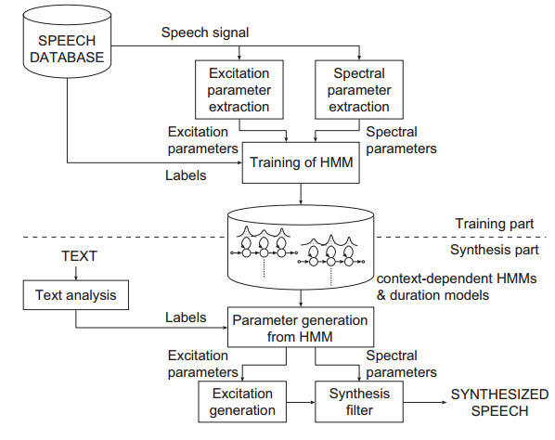
HTS system overview
(Tokuda, Zen, & Black. 2009)

Slide 7
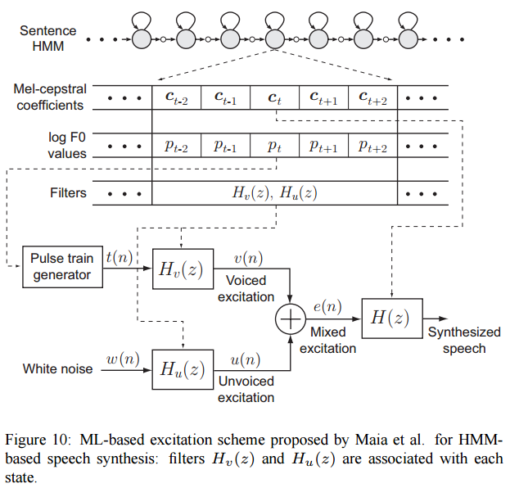
What does the HMM produce?
(Tokuda, Zen, & Black. 2009)

Slide 8
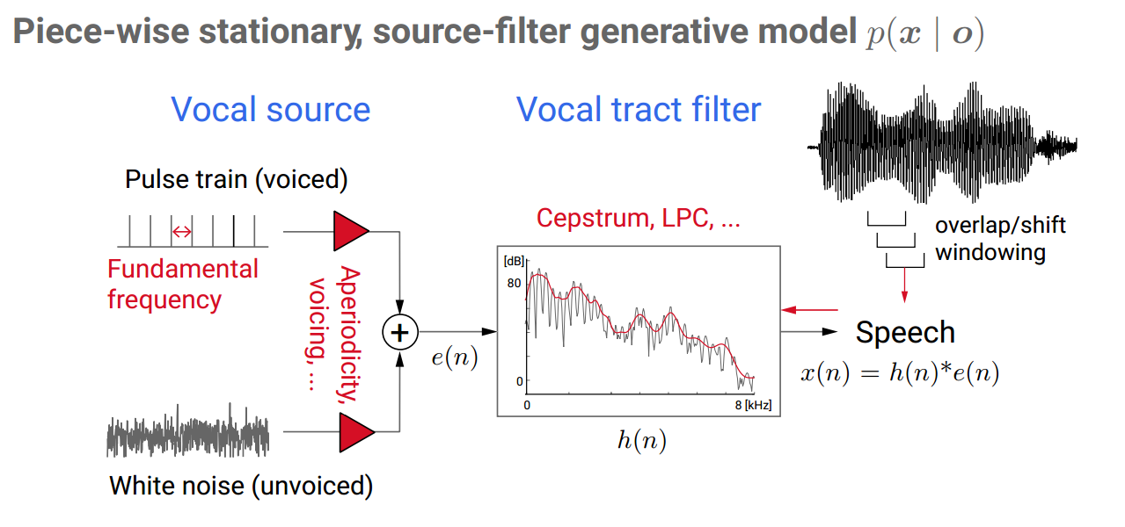
Synthesis with source-filter model
Slide from Heiga Zen

Slide 9
Key Questions in Parametric Synthesis
What parameters do we predict? Usually MFCCs for spectrum, log F0, voicing/excitation
How do we combine them? Exact parameterization and combining them well reduces robotic buzzy effects
How do we make predictions? Choice of HMM, machine learning approaches. Less important than the vocoding/combination issues

Slide 10

HTS Example
Listen to the “low level” buzzy quality characteristic of most parametric systems
Listen to clarity/impact of plosives compared to concatenative example
Notes:
http://www.cstr.ed.ac.uk/projects/festival/morevoices.html

Slide 11
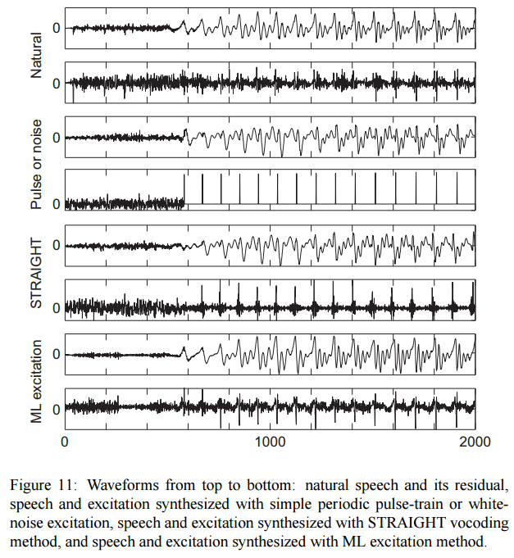
Comparing vocoder/excitation models
(Tokuda, Zen, & Black. 2009)

Slide 12
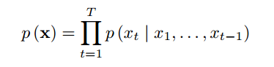
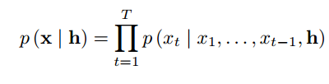
End to end neural net synthesis
TTS as a language model of individual samples
Condition on phoneme sequence / prosodic features h
(Van den Oord et al. 2016)
Notes:
https://deepmind.com/blog/wavenet-generative-model-raw-audio/

Slide 13
Wavenet end to end synthesis
TTS as a language model of individual samples
Condition on phoneme sequence / prosodic features h
(Van den Oord et al. 2016)
Notes:
https://deepmind.com/blog/wavenet-generative-model-raw-audio/

Slide 14
Causal convolution architecture
(Van den Oord et al. 2016)
Notes:
https://deepmind.com/blog/wavenet-generative-model-raw-audio/
https://arxiv.org/abs/1609.03499

Slide 15
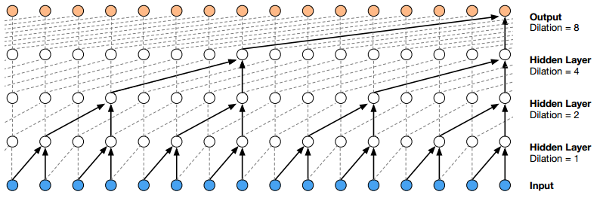
Dilated causal convolutions
(Van den Oord et al. 2016)
Notes:
https://deepmind.com/blog/wavenet-generative-model-raw-audio/

Slide 16
Output encoding
Real values for samples don’t work well
Many quantizations already exist for speech (from telephony mostly)
Output is a softmax classifier over 256 quantized values (mu law)
(Van den Oord et al. 2016)

Slide 17
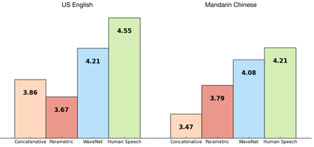
Mean opinion score results
(Van den Oord et al. 2016)

Slide 18
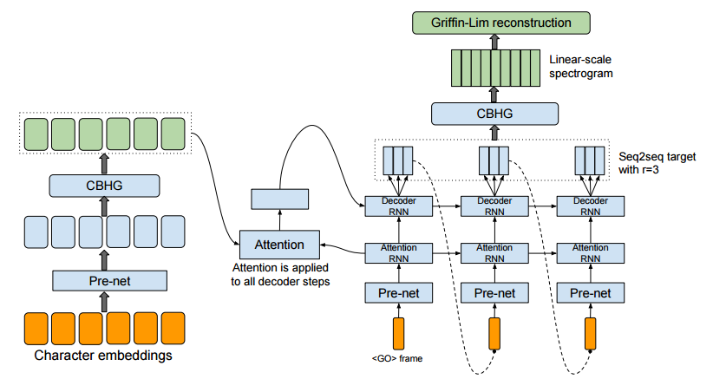
Sequence to sequence with attention
Predict frames and use a more standard vocoder
Input is character sequences rather than phonetic features
(Wang et al. 2017)
Notes:
https://arxiv.org/abs/1703.10135

Slide 19
Intoxication

Slide 20

Hollien et al 2001
Methods:
35 young adults, 19 males, 16 females
given series of doses of alcohol
speech collected at 4 BAC stages
Rainbow passage
difficult words (buttercup, shapupie)
extemp speech (“Tell us about your favorite TV program)
head-mounted mikes
Investigated:
F0 mean and variance
duration/rate of speech
intensity
disfluencies

Slide 21
Hollien et al 2001 Results: F0

Slide 22
Hollien et al 2001 Results: Duration

Slide 23
Hollien et al 2001 Results: Disfluencies

Slide 24
Hollien et al 2001 Results: Magnitudes

Slide 25
Hollien et al 2001 Results: Speaker Specific Effects
20% of speakers did not follow these trends

Slide 26
A famous case study
Johnson, K., Pisoni, D. & Bernacki, R. (1990) Do voice recordings reveal whether a person is intoxicated?: A case study. Phonetica. 47: 215-237.

Slide 27
Exxon Valdez

Slide 28
Was Captain Hazelwood drunk?
Not clear if this is relevant, since seems like other questionable corporate things were going on:
he was asleep below deck
The third mate was in charge of the wheelhouse
the ship’s radar was broken
But is a well-studied case

Slide 29
Johnson et al examined 3 kinds of cues
Segmental Effects (phoneme, syllable, word level)
Disfluencies
Suprasegmental Effects (stress, intonation, etc.)

Slide 30
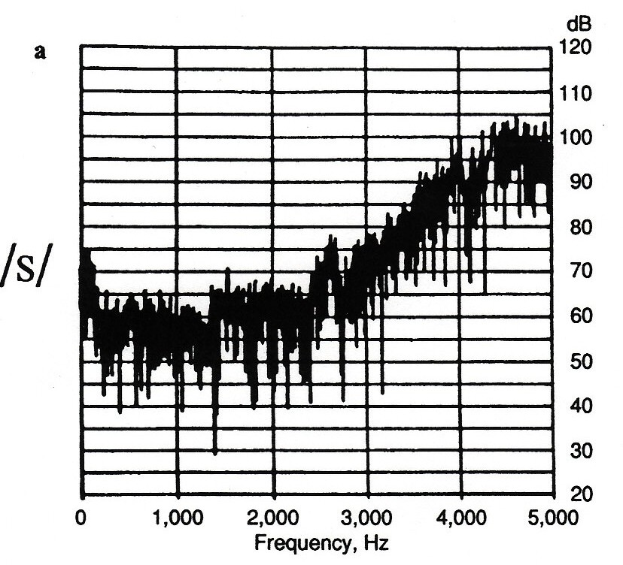
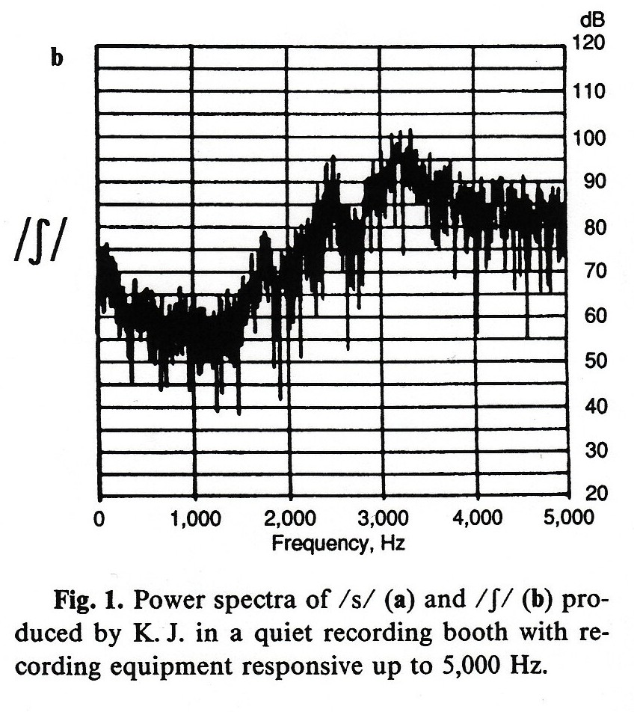
Keith Johnsons /s/ and/ʃ/
e.g. “sun” vs “shun”

Slide 31
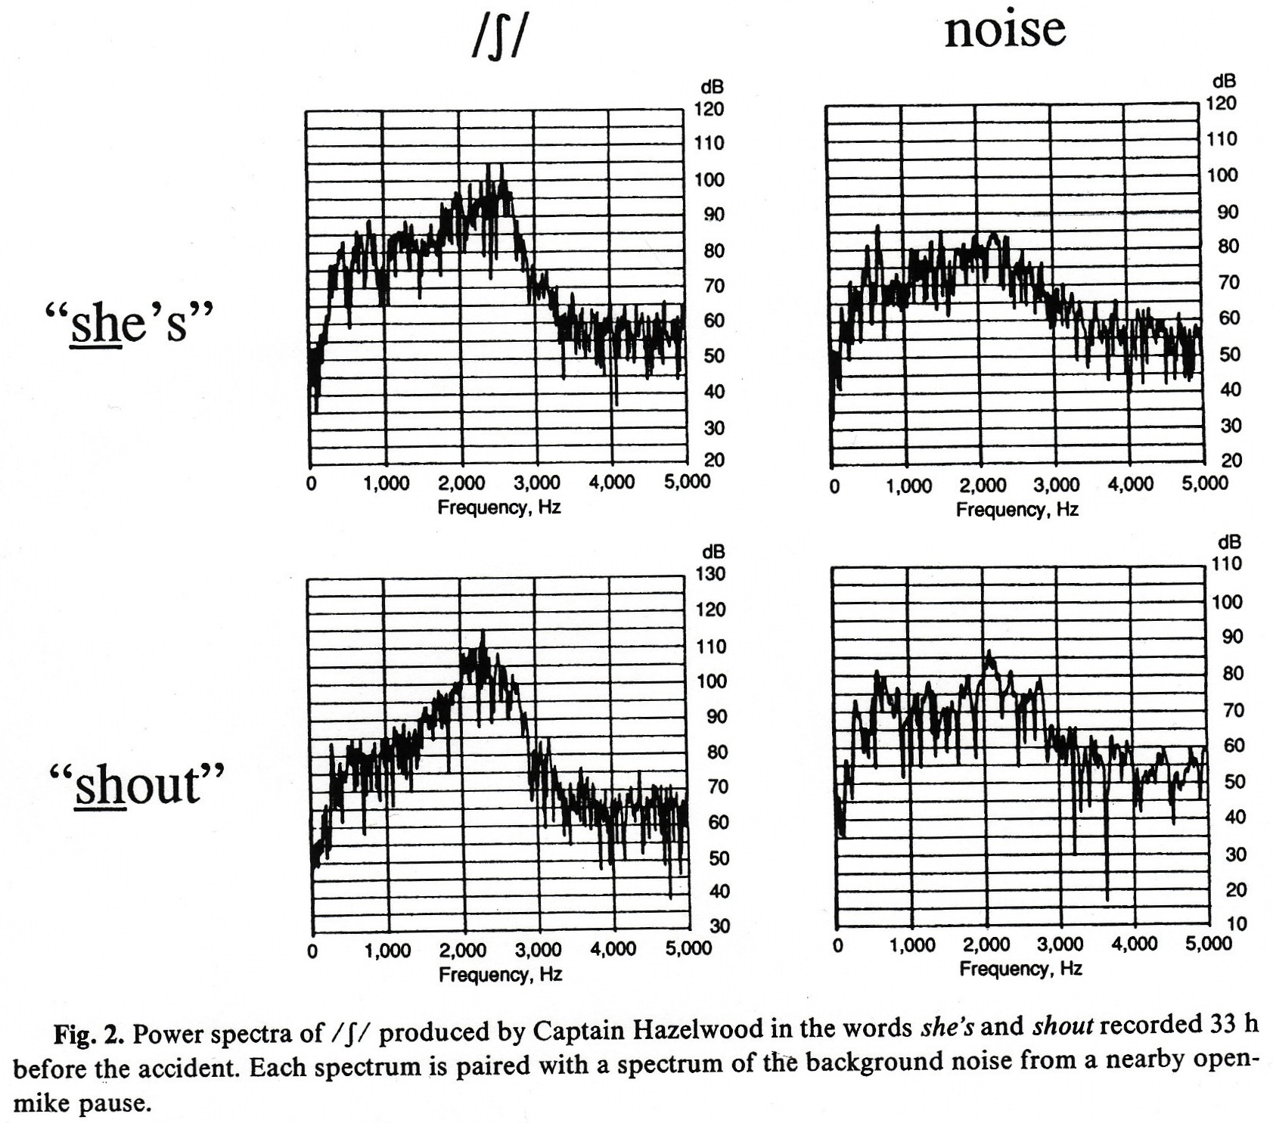
/ʃ/: Captain Hazelwood

Slide 32
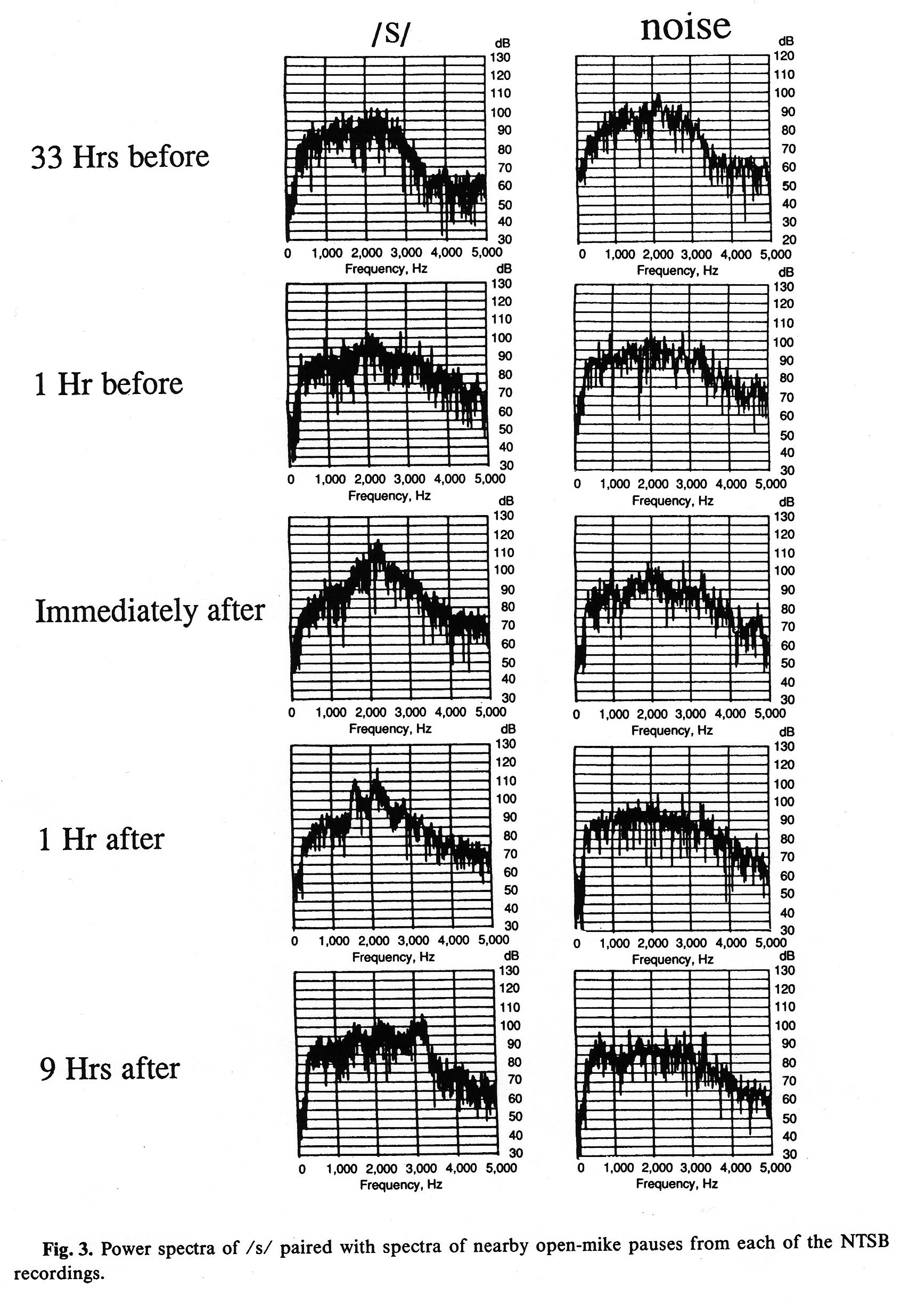

Slide 33
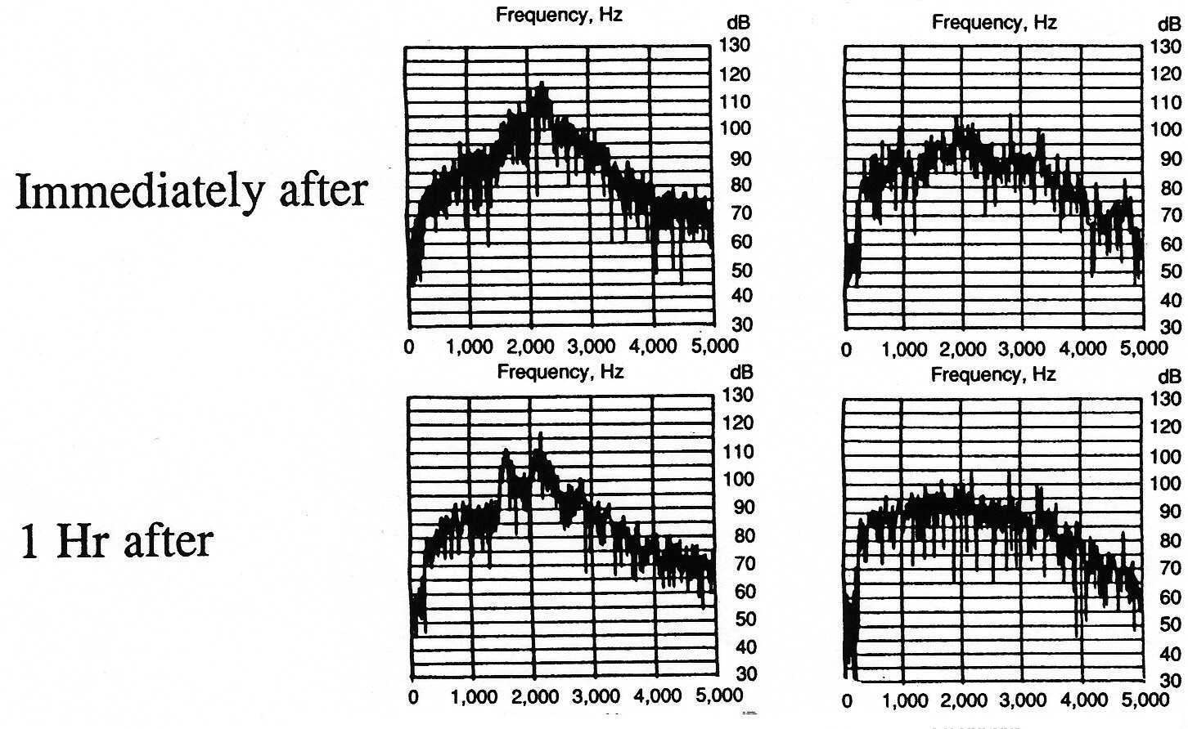

Slide 34
Duration

Slide 35
F0

Slide 36
Summary

Slide 37
Problems
If intoxicated speech, why wasn’t s pronounced as sh 1 hour before?
Other kinds of speaker state could cause drop in F0, slower speech, and disfluencies?
Stress, just having woken up, trauma….

Slide 38
Automatic Classification
Use of prosodic speech characteristics for automated detection of alcohol intoxication Michael Levit, Richard Huber, Anton Batliner, Elmar Noeth
Break utterance into phrases automatically, based on
fundamental frequency (where possible);
zero-crossing rate
energy

Slide 39
Then use 4 classes of features
Prosodic
F0 max, F0 min, energy max, energy min, pause length
Duration of voiced regions, unvoiced regions, etc.
Jitter and shimmer
jitter is variation in pitch
shimmer is variation in energy
Average cepstrum and cepstral slope

Slide 40
Methods
Alcoholized speech samples collected at the Police Academy of Hessen, Germany
120 readings (87 minutes) of a fable
33 male speakers
BAC between 0 and .24/mille
Binary task: above or below 0.8/mille
leave-one-out cross-validation
neural net classifier

Slide 41
Results of Levit et al.
Used dev set to find best classifier
This suggested two feature classes:
Prosodic features
Jitter/shimmer
Results with this classifier
62% phrase-accuracy
69% for the whole speech sample
voting of the phrases

Slide 42
New Corpus!
Alcohol Language Corpus
Florian Schiel et al 2009, 2010
http://www.bas.uni-muenchen.de/forschung/Bas/BasALCeng.html
162 speakers (77 female, 85 male)
recorded in a car (sometimes with engine running)
command and control speech (“turn off the radio”)
spontaneous dialogue, monologue, question answering
read speech
counts of disfluencies, etc
sample, drunk:
sample, sober:

Slide 43
Automatic detection in ALC : Paralinguistic Challenge 2011
Human: 66-72% (Schiel 2011, Ultes, Schmitt, Minker 2011)
Machine: roughly 65%-70%
Example features from winning system:
Bone, Daniel, Matthew Black, Ming Li, Angeliki Metallinou, Sungbok Lee, and Shrikanth S. Narayanan. 2011. Intoxicated Speech Detection by Fusion of Speaker Normalized Hierarchical Features and GMM Supervectors. In INTERSPEECH, pp. 3217-3220.
Prosody (f0, duration, energy, jitter, shimmer)
Spectral (MFCC, MFB log-energy, formants)
Computed over whole utterance and small windows
normalized phoneme duration
iterative speaker normalizaton

Slide 44
Depression

Slide 45
Stirman and Pennebaker
Suicidal poets
300 poems from early, middle, late periods of
9 suicidal poets
9 non-suicidal poets

Slide 46
Stirman and Pennebaker: 2 models
Durkheim disengagement model:
suicidal individual has failed to integrate into society sufficiently, is detached from social life
detach from the source of their pain, withdraw from social relationships, become more self-oriented
prediction:
more self-reference, less group references
Hopelessness model:
Suicide takes place during extended periods of sadness and desperation, pervasive feelings of helplessness, thoughts of death
prediction:
more negative emotion, fewer positive, more refs to death

Slide 47
Methods
156 poems from 9 poets who
committed suicide
published, well-known
in English
have written within 1 year of commmiting suicide
Control poets matched for nationality, education, sex, era.

Slide 48
The poets

Slide 49
Stirman and Pennebaker: Results

Slide 50
Significant factors
Disengagement theory
I, me, mine
we, our, ours
Hopelessness theory
death, grave
Other
sexual words (lust, breast)

Slide 51
Rude et al: Language use of depressed and depression-vulnerable college students
Beck (1967) cognitive theory of depression
depression-prone individuals see the world and themselves in pervasively negative terms
Pyszynski and Greenberg (1987)
think about themselves
after the loss of a central source of self-worth, unable to exit a self-regulatory cycle concerned with efforts to regain what was lost.
results in self-focus, self-blame
Durkheim social integration/disengagement
perception of self as not integrated into society is key to suicidality and possibly depression

Slide 52
Methods
College freshmen
31 currently-depressed (standard inventories)
26 formerly-depressed
67 never-depressed
Session 1: take depression inventory
Session 2: write essay
please describe your deepest thoughts and feelings about being in college… write continuously off the top of your head. Don’t worry about grammar or spelling. Just write continuously.

Slide 53
Results
depressed used more “I,me” than never-depressed
turned out to be only “I”
and used more negative emotional words
not enough “we” to check Durkheim model
formerly depressed participants used more “I” in the last third of the essay

Slide 54
Ramirez-Esparza et al: Depression in English and Spanish
Study 1: Use LIWC counts on posts from 320 English and Spanish forums
80 posts each from depression forums in English and Spanish
80 control posts each from breast cancer forums
Run the following LIWC categories
I
we
negative emotion
positive emotion

Slide 55
Results of Study 1
English
Spanish

Slide 56
Case Study: Online Forum Posts
From depression forums:
404 English posts
404 Spanish posts
Create a term by document matrix of content words
200 most frequent content words
Do a factor analysis
dimensionality reduction in term-document matrix
Used 5 factors

Slide 57
English Factors
a

Slide 58
Spanish Factors
a

Slide 59
Speech features for Depression
Sanchez, Michelle Hewlett, Dimitra Vergyri, Luciana Ferrer, Colleen Richey, Pablo Garcia, Bruce Knoth, and William Jarrold. "Using Prosodic and Spectral Features in Detecting Depression in Elderly Males." In INTERSPEECH, pp. 3001-3004. 2011.
Alghowinem, Sharifa, Roland Goecke, Michael Wagner, Julien Epps, Michael Breakspear, and Gordon Parker. "From Joyous to Clinically Depressed: Mood Detection Using Spontaneous Speech." In FLAIRS Conference. 2012.
Moore, Elliot, Mark A. Clements, John W. Peifer, and Lydia Weisser. "Critical analysis of the impact of glottal features in the classification of clinical depression in speech." Biomedical Engineering, IEEE Transactions on 55, no. 1 (2008): 96-107
D. J. France, R. G. Shiavi, S. Silverman, M. Silverman, and D. M. Wilkes, “Acoustical properties of speech as indicators of depression and suicidal risk,” IEEE Trans. Biomed. Eng., vol. 47, no. 7, pp. 829–837, Jul. 2000.
E. Moore, II, M. Clements, J. Peifer, and L. Weisser, “Comparing objective feature statistics of speech for classifying clinical depression,” in Proc. 26th Ann. Conf. Eng. Med. Biol., 2004, vol. 1, pp. 17–20.
Commonly used features:
F0 variance (monopitch)
loudness variance (monoloudness)
rate of speech (slower)
response delay, pauses
spectral features

Slide 60
Topic 3: Trauma
Social stage model of collective coping (Pennebaker & Harber, 1993). After a traumatic experience:
Stage 1: people cope by sharing their thoughts about the upsetting experience
Stage 2, a few weeks later: decrease in talking, but still thinking about event
Stage 3: 6-8 weeks later: reduction in both talking and thinking
What are the linguistic characteristics of stage 1?

Slide 61
Cohn, Mehl, Pennebaker: Linguistic Markers of Psychological Change Surrounding September 11, 2001
1084 LiveJournal users
all blog entries for 2 months before and after 9/11
Lumped prior two months into one “baseline” corpus.
Investigated changes after 9/11 compared to that baseline
Using LIWC categories

Slide 62
Variables examined
Emotional positivity
difference between LIWC scores for positive emotion words (happy, good, nice) and negative emotion words (kill, ugly, guilty).
cognitive processing
think, question, because: concerned with organizing and intellectually understanding issues
social orientation
talk, share, friends and personal pronouns besides I/me. (essentially counts # of references to other people)

Slide 63
Last factor: Psychological Distancing
psychological distancing
factor-analytic:
+ articles,
+ words > 6 letters long
- I/me/mine
- would/should/could
- present tense verbs
low score = personal, experiential lg, focus on here and now
high score: abstract, impersonal, rational tone

Slide 64
Results

Slide 65
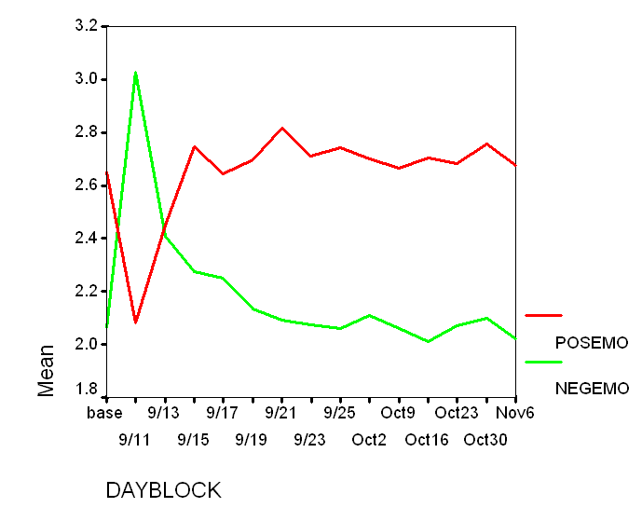
LiveJournal.com September 11, 2001 study: Positive and negative emotion words
Cohn, Mehl, Pennebaker. 2004. Linguistic markers of psychological change surrounding September 11, 2001. Psychological Science 15, 10: 687-693.
Graph from Pennebaker slides

Slide 66
Livejournal.com: I, me, my on or after Sep 11, 2001
Cohn, Mehl, Pennebaker. 2004. Linguistic markers of psychological change surrounding September 11, 2001. Psychological Science 15, 10: 687-693.
Graph from Pennebaker slides

Slide 67
September 11 LiveJournal.com study: We, us, our
Cohn, Mehl, Pennebaker. 2004. Linguistic markers of psychological change surrounding September 11, 2001. Psychological Science 15, 10: 687-693.
Graph from Pennebaker slides

Slide 68
Trauma after Princess Diana’s death
Princess Diana died August 30, 1997
Over the next 4 weeks, scraped all conversations from “The UK Experience” chat room on AOL.
121 chat sessions among 3,139 participants.
Compared to baseline rates:
Increase in we
Decrease in I
Increase in negative emotional words

Slide 69
Texas A&M Bonfire tragedy
Gortner and Pennebaker
Examined student newspaper in the weeks after the tragedy:
Increase in we
Increase in I
Increase in negative emotion

Slide 70
Another domain of trauma? Restaurant Reviews
Jurafsky, Chahuneau, Routledge, Smith 2014.
6562 restaurants
900K reviews www.yelp.com
Negative (★):
The bartender... absolutely horrible... we waited 10 min before we even got her attention... and then we had to wait 45 - FORTY FIVE! - minutes for our entrees… stalk the waitress to get the cheque… she didn't make eye contact or even break her stride to wait for a response…

Slide 71
What makes a bad review bad?
Negative sentiment language
horrible awful terrible worst bad disgusting
narrative
past tense
waited, didn’t make eye contact, was disappointing.
3rd person pronouns
he she his her
other people
manager, customer, minutes, money, waitress, waiter, bill, attitude, management, business, apology, mistake, table, charge, order, hostess,
mentions of we and us
we waited 10 min before we even got her attention... and then we had to wait 45 - FORTY FIVE! - minutes for our entrees… …

Slide 72
We just saw texts with these characteristics!
Negative sentiment, past tense narratives about others
Enormous increase in “we” and “us”: solace in community
Chat group discussions after Princess Diana’s death
Stone, L.D. & Pennebaker, J.W. (2002). Trauma in real time: Talking and avoiding online conversations about the death of Princess Diana. Basic and Applied Social Psychology, 24, 172-182
Blog posts after September 11, 2001
Cohn, M.A., Mehl, M.R., & Pennebaker, J.W. (2004). Linguistic markers of psychological change surrounding September 11, 2001. Psychological Science, 15, 687-693
Student newspaper reports after a campus tragedy
Gortner, E.-M., & Pennebaker, J.W. (2003). The archival anatomy of a disaster: Media coverage and community-wide health effects of the Texas A&M Bonfire Tragedy. Journal of Social and Clinical Psychology, 22, 580-603
Conclusion: Awful reviews are trauma narratives

Slide 73
Personality

Slide 74
Scherer’s typology of affective states
Emotion: relatively brief episode of synchronized response of all or most organismic subsystems in response to the evaluation of an external or internal event as being of major significance
angry, sad, joyful, fearful, ashamed, proud, desperate
Mood: diffuse affect state …change in subjective feeling, of low intensity but relatively long duration, often without apparent cause
cheerful, gloomy, irritable, listless, depressed, buoyant
Interpersonal stance: affective stance taken toward another person in a specific interaction, coloring the interpersonal exchange
distant, cold, warm, supportive, contemptuous
Attitudes: relatively enduring, affectively colored beliefs, preferences predispositions towards objects or persons
liking, loving, hating, valuing, desiring
Personality traits: emotionally laden, stable personality dispositions and behavior tendencies, typical for a person
nervous, anxious, reckless, morose, hostile, envious, jealous

Slide 75
Personality and Cultural Values
Personality refers to the structures and propensities inside a person that explain his or her characteristic patterns of thought, emotion, and behavior.
Personality captures what people are like.
Traits are defined as recurring regularities or trends in people’s responses to their environment.
Cultural values, defined as shared beliefs about desirable end states or modes of conduct in a given culture, influence the expression of a person’s traits.
McGraw-Hill/Irwin Chapter 9

Slide 76
The Big Five Dimensions of Personality
Extraversion vs. Introversion
(sociable, assertive, playful vs. aloof, reserved, shy)
Emotional stability vs. Neuroticism
(calm, unemotional vs. insecure, anxious)
Agreeableness vs. Disagreeable
(friendly, cooperative vs. antagonistic, faultfinding)
Conscientiousness vs. Unconscientious
(self-disciplined, organised vs. inefficient, careless)
Openness to experience
(intellectual, insightful vs. shallow, unimaginative)
76

Slide 77
Aside: Do Animals Have Personalities?
Gosling (1998) studied spotted hyenas. He:
had human observers use personality scales to rate the different hyenas in the group
did a factor analysis on these findings
found five dimensions
three closely resembled the Big Five traits of neuroticism, openness to experience, and agreeableness
Slide from Randall E. Osborne
77

Slide 78
The Big Five Personality Traits
Conscientiousness - dependable, organized, reliable, ambitious, hardworking, and persevering.
McGraw-Hill/Irwin Chapter 9

Slide 79
The Big Five Personality Traits, Cont’d
Agreeableness - warm, kind, cooperative, sympathetic, helpful, and courteous.
Strong desire to obtain acceptance in personal relationships as a means of expressing personality.
Agreeable people focus on “getting along,” not necessarily “getting ahead.”
McGraw-Hill/Irwin Chapter 9

Slide 80
The Big Five Personality Traits, Cont’d
Extraversion - talkative, sociable, passionate, assertive, bold, and dominant.
Easiest to judge in zero acquaintance situations — situations in which two people have only just met.
Prioritize desire to obtain power and influence within a social structure as a means of expressing personality.
High in positive affectivity — a tendency to experience pleasant, engaging moods such as enthusiasm, excitement, and elation.
McGraw-Hill/Irwin Chapter 9

Slide 81
The Big Five Personality Traits: Neuroticism - nervous, moody, emotional, insecure, jealous.
experience unpleasant moods such as hostility, nervousness, and annoyance.
more likely to appraise day-to-day situations as stressful.
less likely to believe they can cope with the stressors that they experience.
related to locus of control (attribute causes of events to themselves or to the external environment)
neurotics hold an external locus of control: believe that the events that occur around them are driven by luck, chance, or fate.
less neurotic people hold internal locus of control: believe that their own behavior dictates events.
McGraw-Hill/Irwin Chapter 9

Slide 82
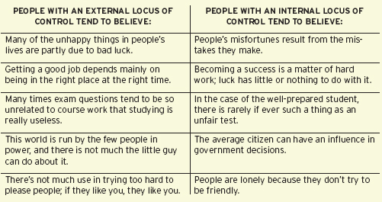
External and Internal Locus of Control
McGraw-Hill/Irwin Chapter 9

Slide 83
The Big Five Personality Traits, Cont’d
Openness to experience - curious, imaginative, creative, complex, refined, and sophisticated.
Also called “Inquisitiveness” or “Intellectualness” or even “Culture.”
high levels of creativity, the capacity to generate novel and useful ideas and solutions.
Highly open individuals are more likely to migrate into artistic and scientific fields.
McGraw-Hill/Irwin Chapter 9

Slide 84
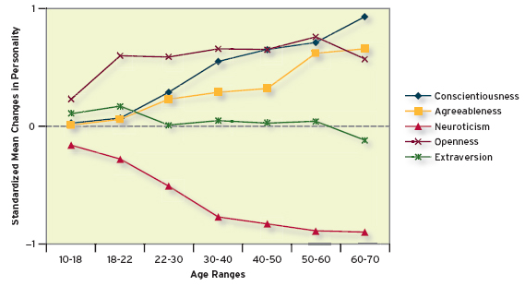
Changes in Big Five Dimensions Over the Life Span
McGraw-Hill/Irwin Chapter 9

Slide 85
Take the Big Five Inventory
http://www.outofservice.com/bigfive/

Slide 86
Corpora for studying personality: Natural speech
Electronically Activated Recorder (EAR)
Mehl, M. R., Pennebaker, J. W., Crow, M. D., Dabbs, J., & Price, J. H. (2001). The Electronically Activated Recorder (EAR): A device for sampling naturalistic daily activities and conversations. Behavior Research Methods, Instruments, and Computers, 33, 517-523.
a modified digital voice recorder that periodically records brief snippets of ambient sounds
Attaches to the belt or in a purse-like bag while participants go about their daily lives.

Slide 87
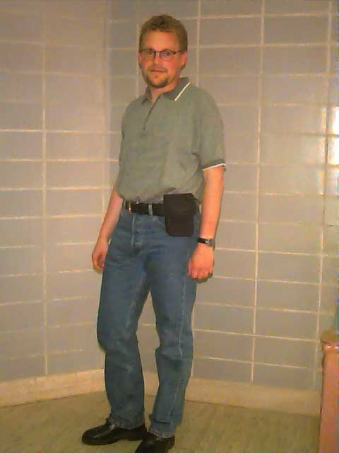
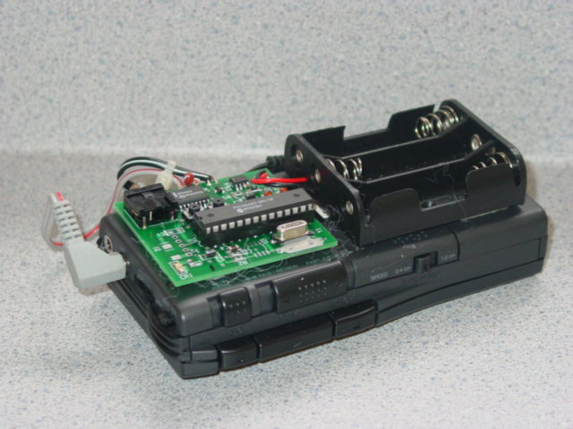
Analog EAR-1: 90 minute tape 1997-2000

Slide 88
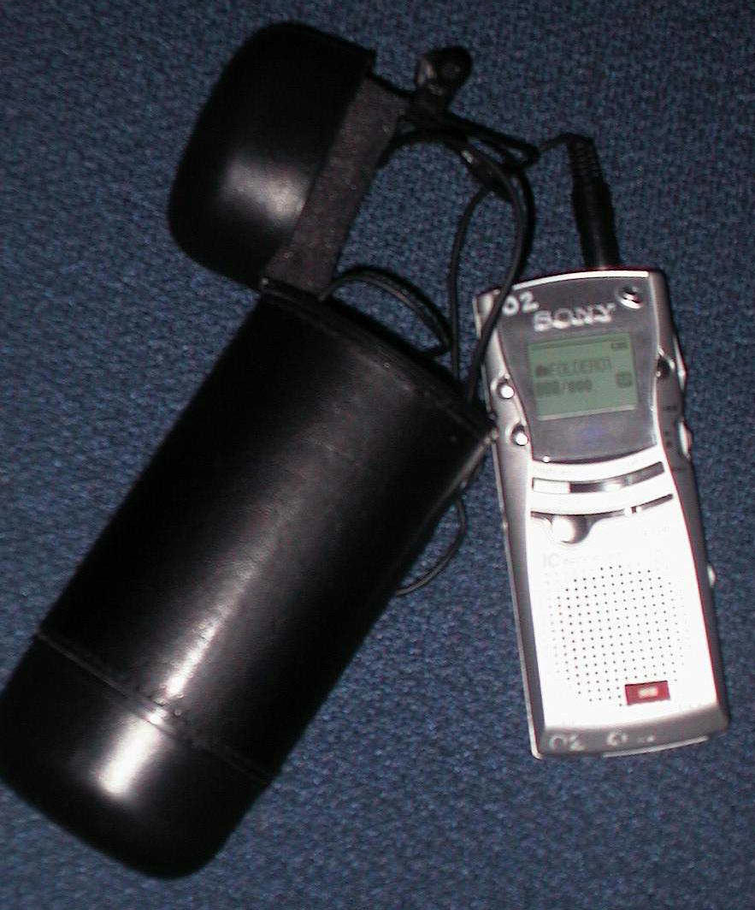
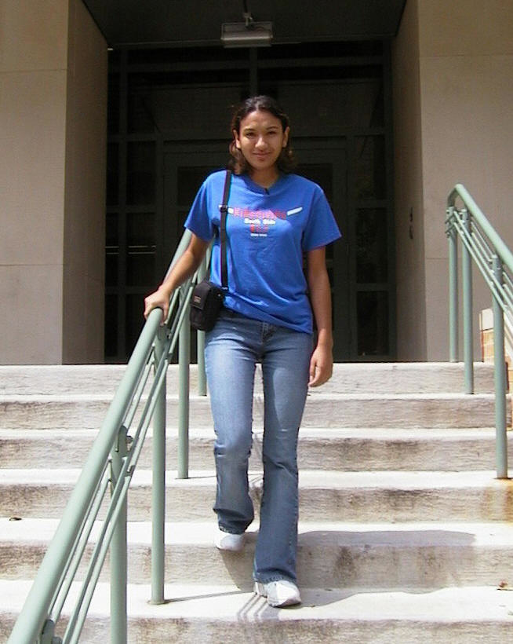
Digital EAR-2: digital voice recorder, flash drive 2001-2004

Slide 89
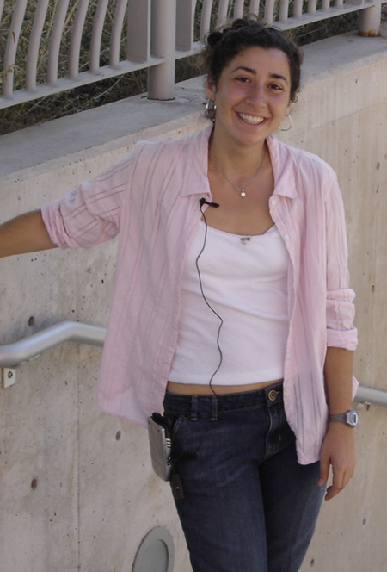
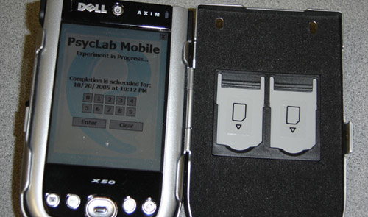
PDA Ear-3 2005-

Slide 90
Mairesse et al. Two Corpora
Pennebaker and King (1999)
2,479 essays from psychology students (1.9 million words), “write whatever comes into your mind” for 20 minutes
Mehl et al. (2006)
Speech from Electronically Activated Recorder (EAR)
Random snippets of conversation recorded, transcribed
96 participants, total of 97,468 words and 15,269 utterances).

Slide 91
Mehl et al. (2006) data
Mehl, Matthias R., Samuel D. Gosling, and James W. Pennebaker. 2006. "Personality in its natural habitat: manifestations and implicit folk theories of personality in daily life." Journal of personality and social psychology
96 psych freshman at UT Austin took the 44-item Big Five Inventory
Agreed to wear EAR two weekdays continuously (when awake)
External mike clipped to collar
30-s on, 12.5-min off cycle = 4.8 recordings/hour
They were told they could erase anything they didn’t want researchers to hear
afterwards they reported wearing about 75% of their waking time
Each sound file
transcribed
coded for environmental situation (location, activity)
23 LIWC variables coded
18 trained students listened to the files and assigned Big Five Inventory scores

Slide 92
Ears (speech) corpus
a

Slide 93
Essays corpus
a

Slide 94
Sample Features

Slide 95
a

Slide 96
Utterance type
Labeled by parsing each utterance and then using heuristic rules based on parse tree:
Commands: imperatives, “can you”, etc.
Backchannels: yeah, ok, uh-huh, huh
Questions
Assertions (anything else)

Slide 97
Prosodic features
Computed via Praat
pitch (mean, min, max, sd):
intensity (mean, min, max, sd)
voiced time
rate of speech (words/second)

Slide 98
Classifiers from Weka
Classification (binary)
C4.5 Decision Tree (J48)
Nearest neighbor
Naïve Bayes
Ripper
Adaboost
SVM with linear kernels
Regression (predict Likert values)
linear regression
M5’ regression tree
SVMOreg
Ranking (training set T of ordered pairs
T = {(x,y)|x,y, are language samples from two individuals, x has a higher score than y for that personality trait}
Rankboost

Slide 99
Ears (speech) corpus
a

Slide 100
Ears (speech) corpus, from observer, Naïve Bayes classifier
a
All
73
73.89
61.33
67.67
57

Slide 101
Summary
Much easier to classifier observer-labeled than self-labeled
Simpler classifiers like NB did well
not much data: 96 people, 97K words

Slide 102
Feature analysis: Observed Extraversion
more words
higher pitch
more concrete, imageable words
greater variation in intensity
greater mean intensity
more word repetitions
M5’ Regression Tree

Slide 103
Agreeableness
-swear Self-assessed: Other-assessed:
-anger pitch variation long words, short sents
+backchannel max intensity
other-assessed:

Slide 104
Conscientiousness
-swear
-anger
-negemotion
Observed:
+insight, +backchannel, +longwords
+word, +posemotion
Self-assessed:
+positive feelings

Slide 105
Openness to experience
Poor performance from Ears data – prosody helped but no language features
But good performance from Essay data
Open/creative/unconventional people
don’t talk about school
use longer and rarer words
don’t talk about friends

Slide 106
Interspeech 2012 Paralinguistic challenge dataset
SPC
Speech clips randomly extracted from Radio Suisse Romand French news broadcasts
640 10-second speech clips from 322 individuals
Emotionally neutral, no familiar words to non-French speakers
Professional (307 samples; journalists) or nonprofessional (333 - interviewees) samples.
Personality assessed by 11 judges

Slide 107
Personality labeled by BFI-10
Extroversion: Q6 – Q1 Agreeableness: Q2 – Q7
Conscientiousness Q8 – Q3 Neuroticism Q9 – Q4
Openness: Q10 – Q5

Slide 108
Accuracy

Slide 109
Regression coefficients

